Slide 1
COE 528 Design Project: Parking Lot
Summer 2020
Uzair Ahmed
Alireza Golband
Syed Wadood

Slide 2
The Problem
Multi Floor application consisting of:
1 manager that can modify, update, delete tickets
0 or more customer accessing the application
One file per ticket information
Ticket number is a random 10 digit number

Slide 3
The Problem
Multi Floor application consisting of:
Manager is verified upon login
Only manager can add, update and modify tickets
Purchased ticket will be stored in its file
No 2 tickets have same numbers

Slide 4
Problem statement
Modelling a real world problem using the approach of object oriented analysis and design approach
Creation of a multi floor parking space application and using the specific thinking and modelling.

Slide 5
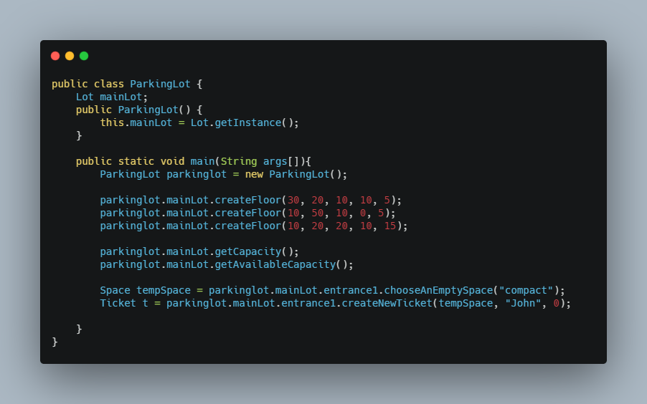
Parking Lot Class
This class does not impact the Interface but it allows for testing of class functions in order to guarantee execution.

Slide 6
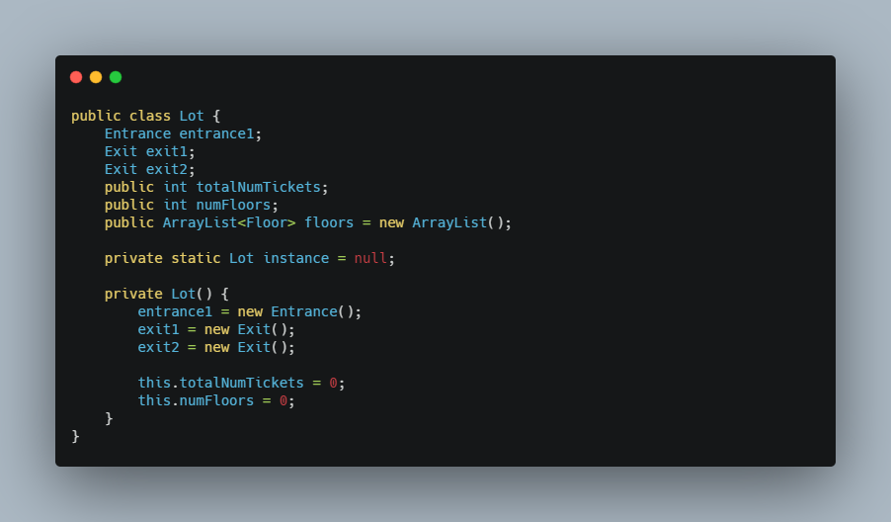
Lot Class
This class is a Singleton, it is only made once and is essential to represent the whole parking lot. It handles all the floors/spaces and keeps track of the quantity of each floor. For our purposes, we made 3 floors with 5 spaces on each floor.

Slide 7
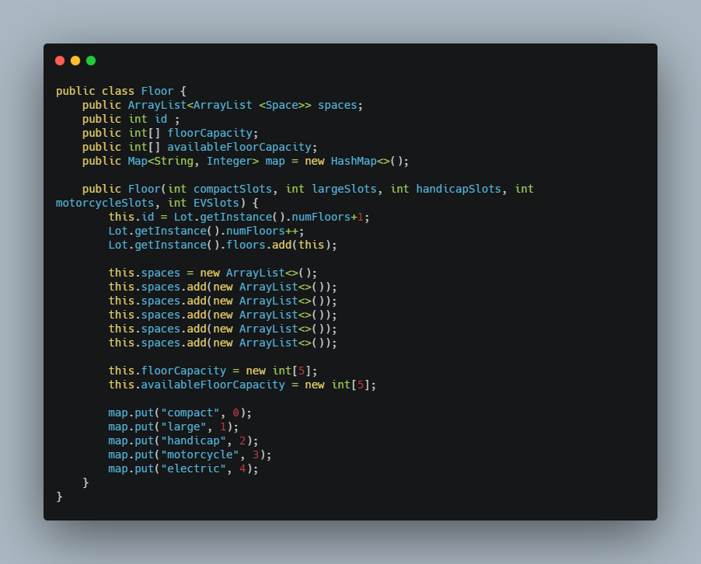
Floor Class
This class manages the parking spaces on a floor-by-floor basis.

Slide 8
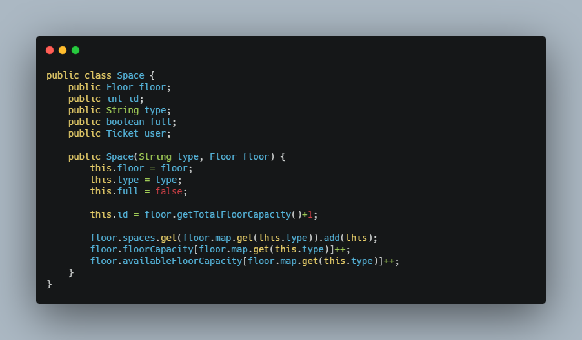
Space Class
This class manages a single Parking Space and whether or not it is currently being used.

Slide 9
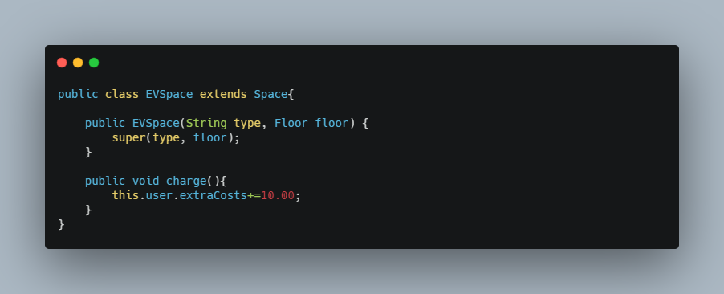
EVSpace class
This class is a Child of Space, it adds a function to apply extra charging costs for Electric Vehicles.

Slide 10
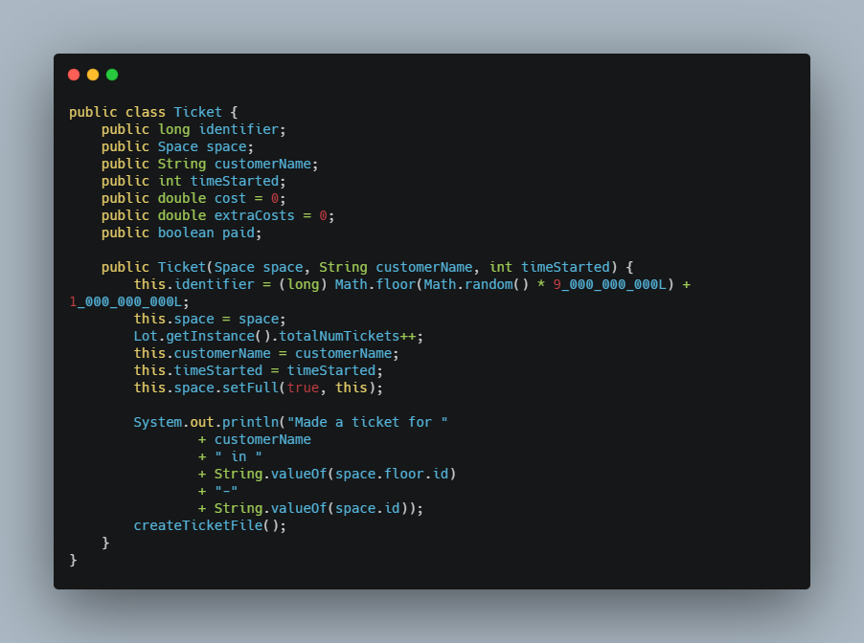
Ticket Class
This class manages a single Ticket, and records the time elapsed and charges incurred for a specific parking.

Slide 11
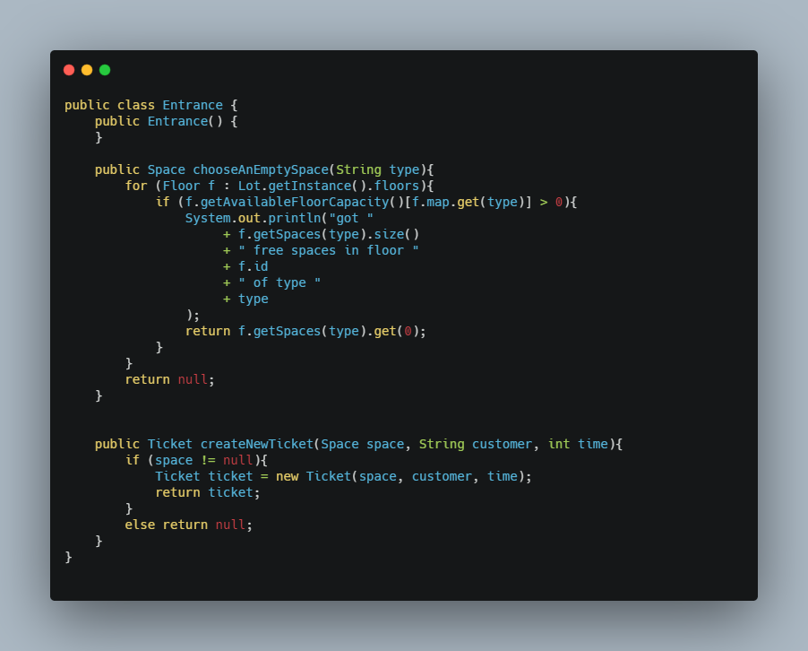
Entrance Class
This class handles handles parking space selection, and Ticket creation upon entering.

Slide 12
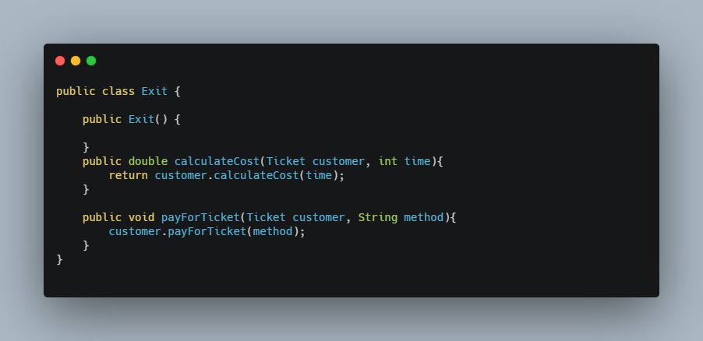
Exit Class
This class handles handles Ticket deletion, and Customer payment upon exit.

Slide 13
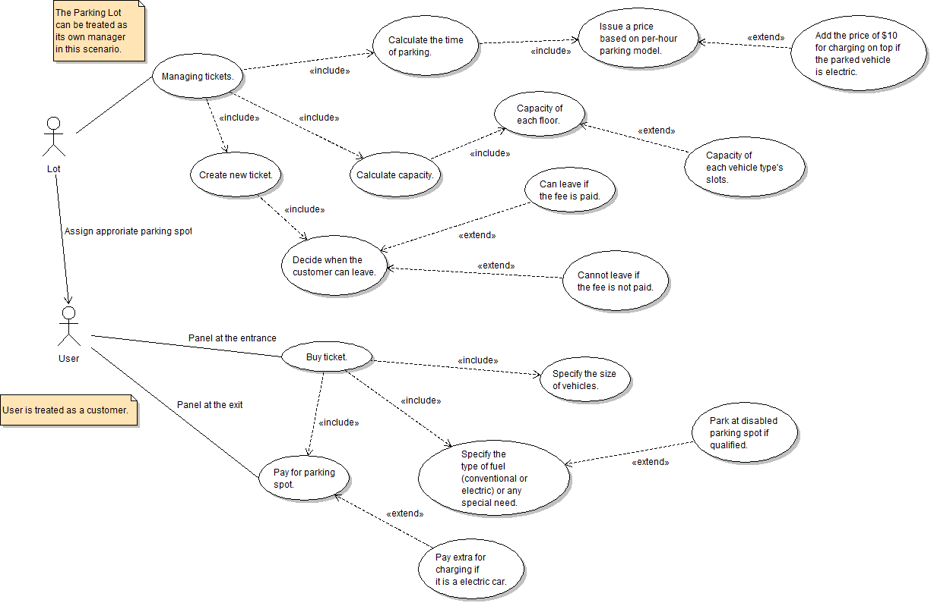
Use Case
1
Larger picture is included in next slide

Slide 15
Division into multiple parts
Actors - Lot and the user/customer
Relations are specifically stated with include and extend so the reader understands clearly
Relationships expand for Lot - managing tickets to calculating the time of parking and price being issued
New paths from managing tickets- creation of new tickets and when a customer can leave and capacity calculation
User relationship to buy ticket - size of vehicle, the type of car and method of payment

Slide 16
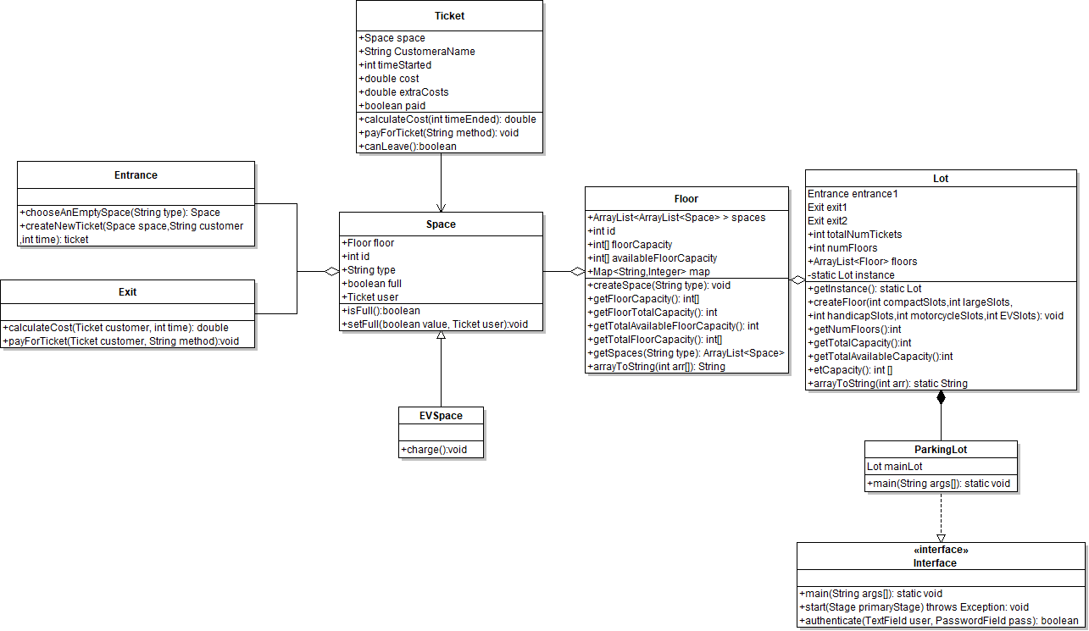
Class Diagram
02
Larger picture is included in next slide
Visualize the effect of classes
Understanding the System
Structure and Relationship of classes

Slide 18
Elements represented using the “+” sign as the public members of classes
Inheritance Relationship- Space class from EVSpace and Ticket Class (Arrow)
Composition Relationship- Space class and Exit class, Floor class and Space class (Full diamonds)
Aggregation Relationship- Lot class and Parking lot Class

Slide 19

Responsibilities
Abdul- Design and Interface, Exception Handling
Uzair- Classes, Debugging, JavaDoc
Alireza - UML, Report, Presentation

Slide 20
Timeline
July 18
July 20
July 21
July 25
July 29
August 2
August 5
Communicating with our group
Requirements gathering
Division of work between our group
Reviewing and focusing on efficiency
Coding almost done and implementing the GUI
Finishing presentation and video recording
Project due date

Slide 21
References
What Is Unified Modeling Language (UML)? Accessed July 5, 2020. https://www.visual-paradigm.com/guide/uml-unified-modeling-language/what-is-uml/.
UML Use Case Diagram Tutorial. (n.d.). Retrieved July 15, 2020, from https://www.lucidchart.com/pages/uml-use-case-diagram

